Slide 1
Secure Network Programming

Slide 2
Security: overview
Chapter goals:
understand principles of network security:
  cryptography and its many uses beyond “confidentiality”
  authentication
  message integrity
security in practice:
  firewalls and intrusion detection systems
  security in application, transport, network, link layers

Slide 3
Security in Networks?
confidentiality: only sender, intended receiver should “understand” message contents
  sender encrypts message
  receiver decrypts message
authentication: sender, receiver want to confirm identity of each other
message integrity: sender, receiver want to ensure message not altered (in transit, or afterwards) without detection
access and availability: services must be accessible and available to users

Slide 4



Friends and enemies: Alice, Bob, Trudy
well-known in network security world
Bob, Alice (lovers!) want to communicate “securely”
Trudy (intruder) may intercept, delete, add messages
Alice
channel
data, control messages
Bob
secure
sender
secure
receiver
data
data
Trudy

Slide 5
Friends and enemies: Alice, Bob, Trudy
Who might Bob and Alice be?
… well, real-life Bobs and Alices!
Web browser/server for electronic transactions (e.g., on-line purchases)
on-line banking client/server
DNS servers
BGP routers exchanging routing table updates
other examples?

Slide 6
There are bad guys (and girls) out there!
Q: What can a “bad guy” do?
A: A lot! (recall section 1.6)
  eavesdrop: intercept messages
  actively insert messages into connection
  impersonation: can fake (spoof) source address in packet (or any field in packet)
  hijacking: “take over” ongoing connection by removing sender or receiver, inserting himself in place
  denial of service: prevent service from being used by others (e.g., by overloading resources)

Slide 7
The language of cryptography
Alice’s
encryption
key
Bob’s
decryption
key
K
A
K
B
plaintext
encryption
algorithm
ciphertext
decryption
algorithm
plaintext
m: plaintext message
K_{A}(m): ciphertext, encrypted with key K_{A}
m = K_{B}(K_{A}(m))

Slide 8
Symmetric key cryptography
K
K
S
S
plaintext
encryption
algorithm
ciphertext
decryption
algorithm
plaintext
K (m)
S
symmetric key crypto: Bob and Alice share same (symmetric) key: K
e.g., key is knowing substitution pattern in mono alphabetic substitution cipher
Q: how do Bob and Alice agree on key value?

Slide 9
Simple encryption scheme
substitution cipher: substituting one thing for another
  monoalphabetic cipher: substitute one letter for another
plaintext: abcdefghijklmnopqrstuvwxyz
ciphertext: mnbvcxzasdfghjklpoiuytrewq
e.g.:
Plaintext: bob. i love you. alice
ciphertext: nkn. s gktc wky. mgsbc
Encryption key: mapping from set of 26 letters
to set of 26 letters

Slide 10
Symmetric key crypto: DES
DES: Data Encryption Standard
US encryption standard [NIST 1993]
56-bit symmetric key, 64-bit plaintext input
block cipher with cipher block chaining
how secure is DES?
  DES Challenge: 56-bit-key-encrypted phrase decrypted (brute force) in less than a day
  no known good analytic attack
making DES more secure:
  3DES: encrypt 3 times with 3 different keys

Slide 11
AES: Advanced Encryption Standard
symmetric-key NIST standard, replaced DES (Nov 2001)
processes data in 128 bit blocks
128, 192, or 256 bit keys
brute force decryption (try each key) taking 1 sec on DES, takes 149 trillion years for AES

Slide 12

Public Key Cryptography
symmetric key crypto:
requires sender, receiver know shared secret key
Q: how to agree on key in first place (particularly if never “met”)?
public key crypto
radically different approach [Diffie-Hellman76, RSA78]
sender, receiver do not share secret key
public encryption key known to all
private decryption key known only to receiver

Slide 13
Public Key Cryptography
+
Bob’s public key
K
B
-
Bob’s private key
K
B
plaintext
message, m
encryption
algorithm
ciphertext
decryption
algorithm
plaintext
+
-
+
K (m)
m = K (K (m))
B
B
B
Wow - public key cryptography revolutionized 2000-year-old (previously only symmetric key) cryptography!
similar ideas emerged at roughly same time, independently in US and UK (classified)

Slide 14
Public key encryption algorithms
requirements:
+
.
-
.
1
need K ( ) and K ( ) such that
B
B
-
+
K (K (m)) = m
B
B
+
2
given public key K , it should be impossible to compute private key K
B
-
B
RSA: Rivest, Shamir, Adelson algorithm

Slide 15
Prerequisite: modular arithmetic
x mod n = remainder of x when divide by n
facts:
  [(a mod n) + (b mod n)] mod n = (a+b) mod n
  [(a mod n) - (b mod n)] mod n = (a-b) mod n
  [(a mod n) * (b mod n)] mod n = (a*b) mod n
thus
(a mod n)^{d} mod n = a^{d} mod n
example: x=14, n=10, d=2:
(x mod n)^{d} mod n = 4² mod 10 = 6
x^{d} = 14² = 196 x^{d} mod 10 = 6

Slide 16
RSA: getting ready
message: just a bit pattern
bit pattern can be uniquely represented by an integer number
thus, encrypting a message is equivalent to encrypting a number
example:
m= 10010001. This message is uniquely represented by the decimal number 145.
to encrypt m, we encrypt the corresponding number, which gives a new number (the ciphertext).

Slide 17
RSA: Creating public/private key pair
1. choose two large prime numbers p, q. (e.g., 1024 bits each)
2. compute n = pq, z = (p-1)(q-1)
3. choose e (with e<n) that has no common factors with z (e, z are “relatively prime”).
4. choose d such that ed-1 is exactly divisible by z. (in other words: ed mod z = 1 ).
5. public key is (n,e). private key is (n,d).
+
-
K
K
B
B

Slide 18
RSA: encryption, decryption
0. given (n,e) and (n,d) as computed above
1. to encrypt message m (<n), compute
e
c = m mod n
2. to decrypt received bit pattern, c, compute
d
m = c mod n
magic happens!
e
d
m = (m mod n)
mod n
c

Slide 19
RSA example:
Bob chooses p=5, q=7. Then n=35, z=24.
e=5 (so e, z relatively prime).
d=29 (so ed-1 exactly divisible by z).
encrypting 8-bit messages.
m
e
e
bit pattern
m
c = m mod n
encrypt:
0000l000
12
24832
17
d
d
c
c
m = c mod n
decrypt:
17
481968572106750915091411825223071697
12

Slide 20
Why does RSA work?
must show that c^{d} mod n = m, where c = m^{e} mod n
fact: for any x and y: x^{y} mod n = x^{(y mod z)} mod n
  where n= pq and z = (p-1)(q-1)
thus,
c^{d} mod n = (m^{e} mod n)^{d} mod n
= m^{ed} mod n
= m^{(ed mod z)} mod n
= m¹ mod n
= m

Slide 21
RSA: another important property
The following property will be very useful later:
-
+
+
-
K (K (m)) = m
=
K (K (m))
B
B
B
B
use public key first, followed by private key
use private key first, followed by public key
result is the same!

Slide 22
Why
-
+
+
-
K (K (m)) = m
=
K (K (m))
?
B
B
B
B
follows directly from modular arithmetic:
(m^{e} mod n)^{d} mod n = m^{ed} mod n
= m^{de} mod n
= (m^{d} mod n)^{e} mod n

Slide 23
Authentication
Goal: Bob wants Alice to “prove” her identity to him
Protocol ap1.0: Alice says “I am Alice”
“I am Alice”
failure scenario??

Slide 24
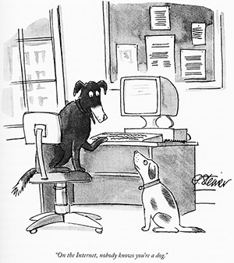
Authentication
Goal: Bob wants Alice to “prove” her identity to him
Protocol ap1.0: Alice says “I am Alice”
in a network, Bob can not “see” Alice, so Trudy simply declares herself to be Alice
“I am Alice”

Slide 25
Authentication: another try
Goal: Bob wants Alice to “prove” her identity to him
Protocol ap2.0: Alice says “I am Alice” in an IP packet containing her source IP address
Alice’s
IP address
“I am Alice”
failure scenario??

Slide 26
Authentication: another try
Goal: Bob wants Alice to “prove” her identity to him
Protocol ap2.0: Alice says “I am Alice” in an IP packet containing her source IP address
Trudy can create
a packet “spoofing”
Alice’s address
Alice’s
IP address
“I am Alice”

Slide 27
Authentication: a third try
Goal: Bob wants Alice to “prove” her identity to him
Protocol ap3.0: Alice says “I am Alice” and sends her secret password to “prove” it.
Alice’s
IP addr
Alice’s
password
“I am Alice”
failure scenario??
Alice’s
IP addr
OK

Slide 28
Authentication: a third try
Goal: Bob wants Alice to “prove” her identity to him
Protocol ap3.0: Alice says “I am Alice” and sends her secret password to “prove” it.
playback attack: Trudy records Alice’s packet
and later
plays it back to Bob
Alice’s
IP addr
Alice’s
password
“I am Alice”
Alice’s
IP addr
Alice’s
password
“I am Alice”
Alice’s
IP addr
OK

Slide 29
Authentication: a modified third try
Goal: Bob wants Alice to “prove” her identity to him
Protocol ap3.0: Alice says “I am Alice” and sends her encrypted secret password to “prove” it.
Alice’s
IP addr
encrypted
password
“I am Alice”
failure scenario??
Alice’s
IP addr
OK

Slide 30
Authentication: a modified third try
Goal: Bob wants Alice to “prove” her identity to him
Protocol ap3.0: Alice says “I am Alice” and sends her encrypted secret password to “prove” it.
Alice’s
IP addr
encrypted
password
“I am Alice”
playback attack still works: Trudy records Alice’s packet
and later plays it back to Bob
Alice’s
IP addr
encrypted
password
“I am Alice”
Alice’s
IP addr
OK

Slide 31
Authentication: a fourth try
Goal: avoid playback attack
nonce: number (R) used only once-in-a-lifetime
protocol ap4.0: to prove Alice “live”, Bob sends Alice nonce, R
Alice must return R, encrypted with shared secret key
“I am Alice”
R
K (R)
Bob know Alice is live, and only Alice knows key to encrypt nonce, so it must be Alice!
A-B
Failures, drawbacks?

Slide 32
Authentication: ap5.0
ap4.0 requires shared symmetric key - can we authenticate using public key techniques?
ap5.0: use nonce, public key cryptography
“I am Alice”
R
Bob computes
+
-
-
K
(K (R)) = R
K (R)
A
A
A
and knows only Alice could have the private key, that encrypted R such that
Send me your public key
+
K (R)
+
-
A
K
A
(K (R)) = R
A

Slide 33
Authentication: ap5.0 – there’s still a flaw!
man (or woman) in the middle attack: Trudy poses as Alice (to Bob) and as Bob (to Alice)
I am Alice
I am Alice
?
R
-
K (R)
T
R
Where are mistakes made here?
Send me your public key
-
+
K (R)
K
Bob computes
A
T
+
-
Send me your public key
K
(K (R)) = R,
+
T
T
K
authenticating
Trudy as Alice
A
Trudy recovers m:
+
+
-
+
K (m)
Trudy recovers Bob’s m:
m = K (K (m))
Bob sends a personal message, m to Alice
-
+
K (m)
T
T
m = K (K (m))
A
T
A
A
sends m to Alice encrypted with Alice’s public key
and she and Bob meet a week later in person and discuss m, not knowing Trudy knows m

Slide 34

Digital signatures
cryptographic technique analogous to hand-written signatures:
sender (Bob) digitally signs document: he is document owner/creator.
verifiable, nonforgeable: recipient (Alice) can prove to someone that Bob, and no one else (including Alice), must have signed document
simple digital signature for message m:
  Bob signs m by encrypting with his private key K_{B}, creating “signed” message, K_{B}⁻(m)
-
Bob’s private
key
-
Bob’s message, m
K
m,K
(m)
B
B
Dear Alice
Oh, how I have missed you. I think of you all the time! …(blah blah blah)
Bob
Dear Alice
Oh, how I have missed you. I think of you all the time! …(blah blah blah)
Bob
Public key
encryption
algorithm
-
K
(m)
B

Slide 35
Digital signatures
-
suppose Alice receives msg m, with signature: m, K_{B}(m)
Alice verifies m signed by Bob by applying Bob’s public key K_{B} to K_{B}(m) then checks K_{B}(K_{B}(m) ) = m.
If K_{B}(K_{B}(m) ) = m, whoever signed m must have used Bob’s private key
+
-
+
-
+
-
Alice thus verifies that:
  Bob signed m
  no one else signed m
  Bob signed m and not m’
non-repudiation:
  Alice can take m, and signature K_{B}(m) to court and prove that Bob signed m
-

Slide 36
Message digests
computationally expensive to public-key-encrypt long messages
goal: fixed-length, easy- to-compute digital “fingerprint”
apply hash function H to m, get fixed size message digest, H(m)
large
message
m
H: Hash
Function
H(m)
Hash function properties:
many-to-1
produces fixed-size msg digest (fingerprint)
given message digest x, computationally infeasible to find m such that x = H(m)

Slide 37
Internet checksum: poor crypto hash function
Internet checksum has some properties of hash function:
produces fixed length digest (16-bit sum) of message
is many-to-one
but given message with given hash value, it is easy to find another message with same hash value:
message
ASCII format
message
ASCII format
I O U 1
0 0 . 9
9 B O B
49 4F 55 31
30 30 2E 39
39 42 D2 42
I O U 9
0 0 . 1
9 B O B
49 4F 55 39
30 30 2E 31
39 42 D2 42
B2 C1 D2 AC
different messages
but identical checksums!
B2 C1 D2 AC

Slide 38
Digital signature = signed message digest
Bob sends digitally signed message:
Alice verifies signature, integrity of digitally signed message:
large
message
m
H: Hash
Function
H(m)
encrypted
message digest
-
K_{B}(H(m))
digital
signature
(encrypt)
Bob’s
private
key
large
message
m
-
K
B
digital
signature
(decrypt)
Bob’s
public
key
+
encrypted
message digest
H: Hash
function
K
B
+
-
K_{B}(H(m))
H(m)
H(m)
?
equal

Slide 39
Hash function algorithms
MD5 hash function widely used (RFC 1321)
  computes 128-bit message digest in 4-step process.
  arbitrary 128-bit string x, appears difficult to construct msg m whose MD5 hash is equal to x
SHA-1 is also used
  US standard [NIST, FIPS PUB 180-1]
  160-bit message digest

Slide 40
Authentication: ap5.0 – let’s fix it!!
Recall the problem: Trudy poses as Alice (to Bob) and as Bob (to Alice)
I am Alice
I am Alice
?
R
-
K (R)
T
R
Where are mistakes made here?
Send me your public key
-
+
K (R)
K
Bob computes
A
T
+
-
Send me your public key
K
(K (R)) = R,
+
T
T
K
authenticating
Trudy as Alice
A
Trudy recovers m:
+
+
-
+
K (m)
Trudy recovers Bob’s m:
m = K (K (m))
Bob sends a personal message, m to Alice
-
+
K (m)
T
T
m = K (K (m))
A
T
A
A
sends m to Alice encrypted with Alice’s public key
and she and Bob meet a week later in person and discuss m, not knowing Trudy knows m

Slide 41
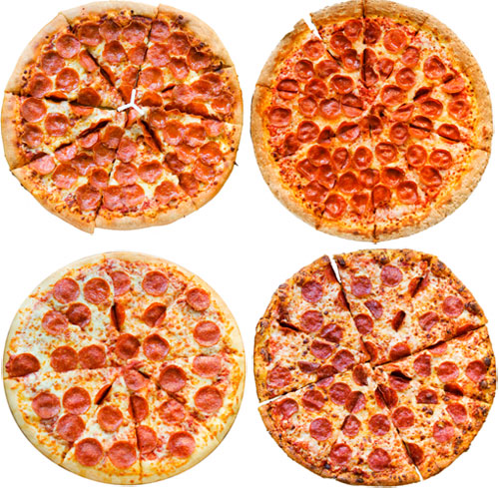
Need for certified public keys
motivation: Trudy plays pizza prank on Bob
  Trudy creates e-mail order:
  Dear Pizza Store, Please deliver to me four pepperoni pizzas. Thank you, Bob
  Trudy signs order with her private key
  Trudy sends order to Pizza Store
  Trudy sends to Pizza Store her public key, but says it’s Bob’s public key
  Pizza Store verifies signature; then delivers four pepperoni pizzas to Bob
  Bob doesn’t even like pepperoni

Slide 42
Public key Certification Authorities (CA)
certification authority (CA): binds public key to particular entity, E
entity (person, website, router) registers its public key with CE provides “proof of identity” to CA
  CA creates certificate binding identity E to E’s public key
  certificate containing E’s public key digitally signed by CA: CA says “this is E’s public key”
Bob’s
public
key
digital
signature
(encrypt)
+
+
K
K
B
B
CA’s
private
key
-
certificate for Bob’s public key, signed by CA
Bob’s
identifying information
K
CA

Slide 43
Public key Certification Authorities (CA)
when Alice wants Bob’s public key:
  gets Bob’s certificate (Bob or elsewhere)
  apply CA’s public key to Bob’s certificate, get Bob’s public key
+
digital
signature
(decrypt)
Bob’s
public
key
K
+
B
K
B
CA’s
public
key
+
K
CA

Slide 44
Transport-layer security (TLS)
widely deployed security protocol above the transport layer
  supported by almost all browsers, web servers: https (port 443)
provides:
  confidentiality: via symmetric encryption
  integrity: via cryptographic hashing
  authentication: via public key cryptography
all techniques we have studied!
history:
  early research, implementation: secure network programming, secure sockets
  secure socket layer (SSL) deprecated [2015]
  TLS 1.3: RFC 8846 [2018]

Slide 45
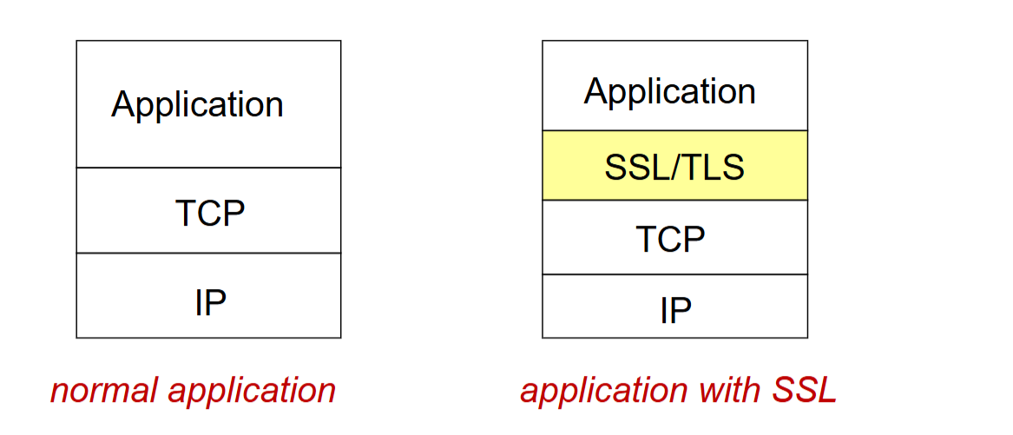
SSL/TLS and TCP/IP
SSL/TLS provides application programming interface (API) to applications
C, Java, Python SSL/TLS libraries/classes readily available

Slide 46
Transport-layer security (TLS)
widely deployed security protocol above the transport layer
  supported by almost all browsers, web servers: https (port 443)
provides:
  confidentiality: via symmetric encryption
  integrity: via cryptographic hashing
  authentication: via public key cryptography
all techniques we have studied!
history:
  early research, implementation: secure network programming, secure sockets
  secure socket layer (SSL) deprecated [2015]
  TLS 1.3: RFC 8846 [2018]

Slide 47
Transport-layer security: what’s needed?
let’s build a toy TLS protocol, t-tls, to see what’s needed!
we’ve seen the “pieces” already:
handshake: Alice, Bob use their certificates, private keys to authenticate each other, exchange or create shared secret
key derivation: Alice, Bob use shared secret to derive set of keys
data transfer: stream data transfer: data as a series of records
  not just one-time transactions
connection closure: special messages to securely close connection

Slide 48
Transport-layer security (TLS)
TLS provides an API that any application can use
an HTTP view of TLS:
HTTP 1.0
HTTP/2
HTTP/2 (slimmed)
Application
HTTP/3
TLS
QUIC
Transport
TCP
TCP
UDP
Network
IP
IP
IP
HTTP/2 over TCP
HTTP/2 over TCP
HTTP/2 over QUIC
(which incorporates TLS)
over UDP

